Slide 1
Kickstarter
Characteristics and predictability of successful campaigns
Analysis and presentation by Randolph Pratt

Slide 2
Dataset:
Data from Kickstarter pre-scraped and located on Kaggle.com
Columns:
ID, name, category, currency, goal, pledged, country, usd pledged, state, deadline, launched, main_category, usd_pledged_real, usd_goal_real, backers
*highlighted features are the utilized variables*

Slide 3
Question:
How can Kickstarter maximize revenue through successful campaigns?

Slide 4
Why is this question relevant to our company?
Kickstarter takes:
5% from successful campaigns
0% from unsuccessful campaigns
Kickstarter has limited resources for marketing and guidance.
Therefore, to maximize revenue, a predictive algorithm can assist the marketing department in capitalizing on a campaign’s maximum potential.

Slide 5
Hypothesis:
After this analysis we should be able to identify key variables we can manipulate to further increase the odds of success.
Variables that we cannot manipulate, such as country of origin, we can provide clients with advice on setting achievable goals.
It is suspected the largest impact will be “country”, the “main_category” of the campaign, and the “date launched”. While “country” is not able to be manipulated, “launch date” and “main_category” can be easily manipulated.

Slide 6
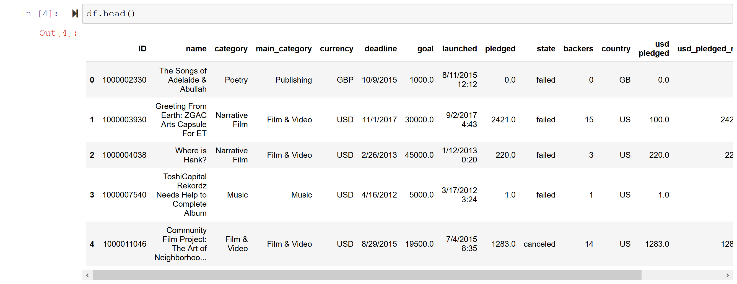
Data Transformation:
The data was collected from Kaggle and already in a pandas readable format.

Slide 7
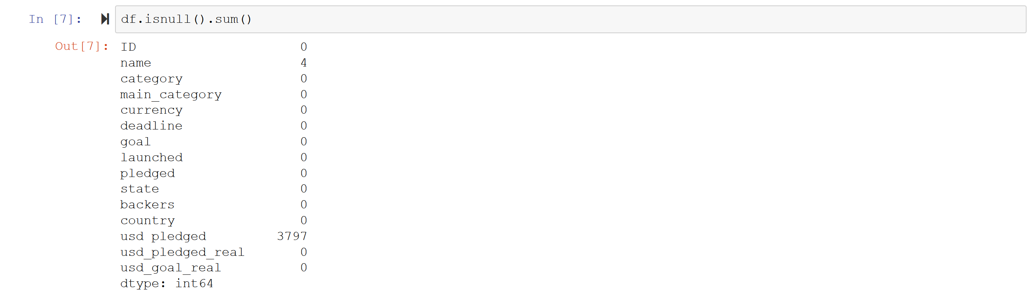
Data Cleaning:
The data had virtually no missing values, therefore, dropping the null values was justified.

Slide 8


Data Cleaning:
Dropped redundant columns as measured by correlation
Convert non-numerical data to numerical (dummy variable)
Convert date/time entries into pandas' date/time feature
Create the feature "elapsed" by determining time used from start to completion

Slide 9
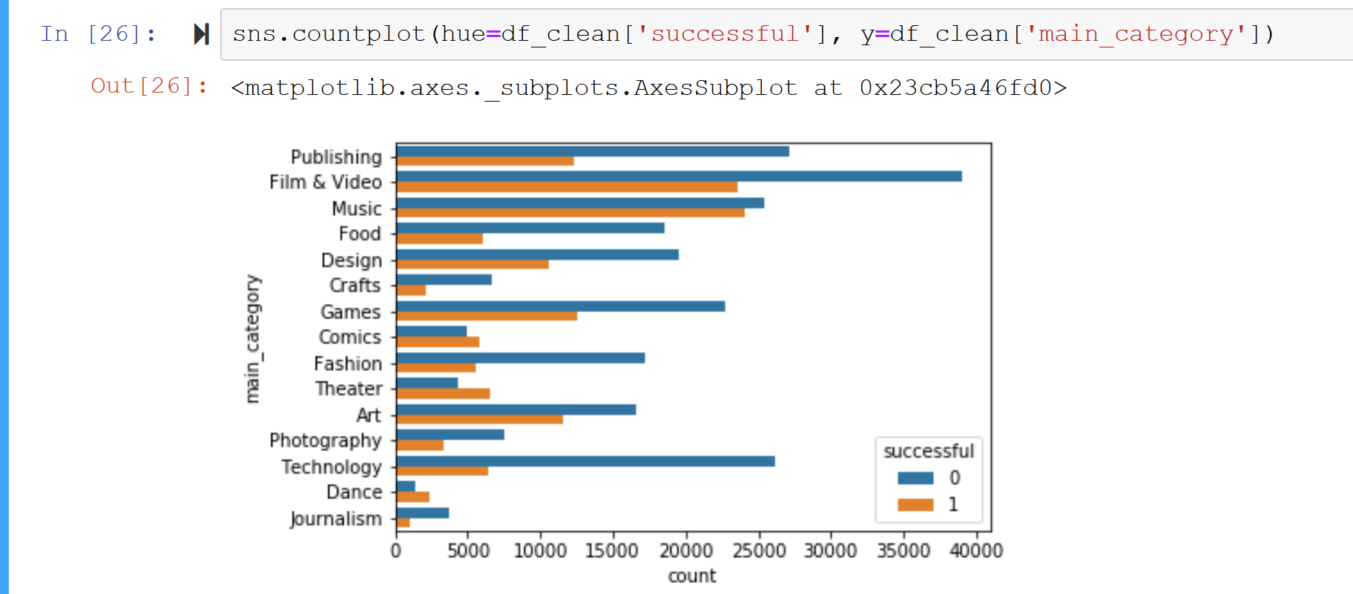
Percentage of un/successful campaigns compared to each main category
Bar lengths represent the quantity of projects within that category.
"Music" is the largest and safest ratio of successful to unsuccessful campaigns.

Slide 10
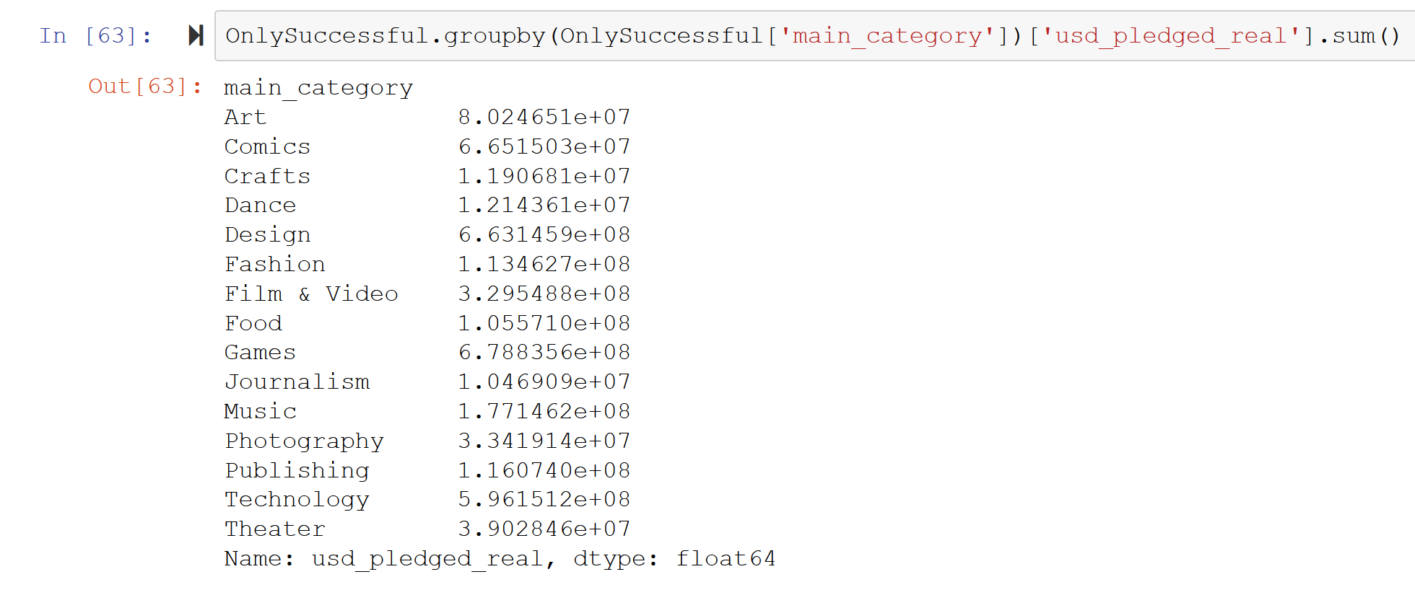
The top 3 categories where we can find most of the revenue are "Games", "Design", "Technology".
Above chart is of only successful campaigns, how much revenue each category brought in.

Slide 11

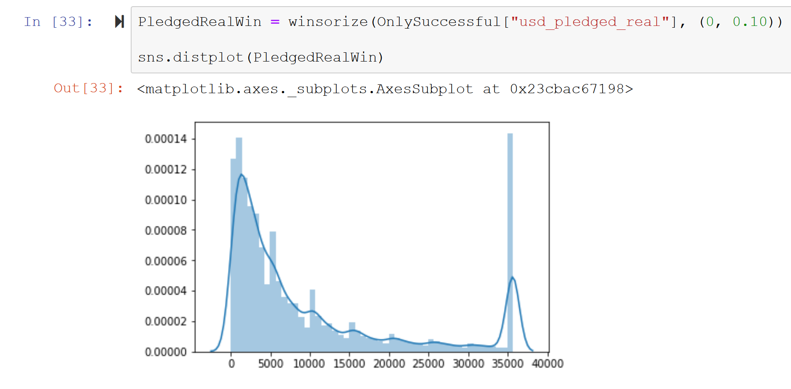


Distribution of pledged U.S. dollars within successful campaigns. Heavy successful campaigns at one end of the spectrum is not the norm. Most campaigns fall below $10,000.

Slide 12
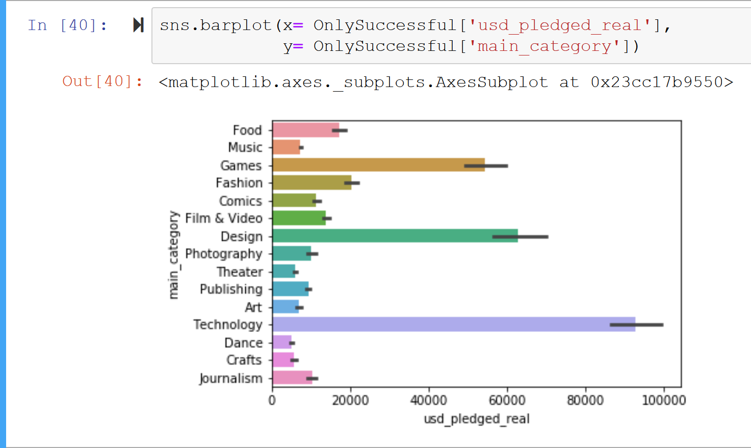
Money makers: The top 3 categories where we can find most of the revenue are "Technology", "Design", "Games".

Slide 13
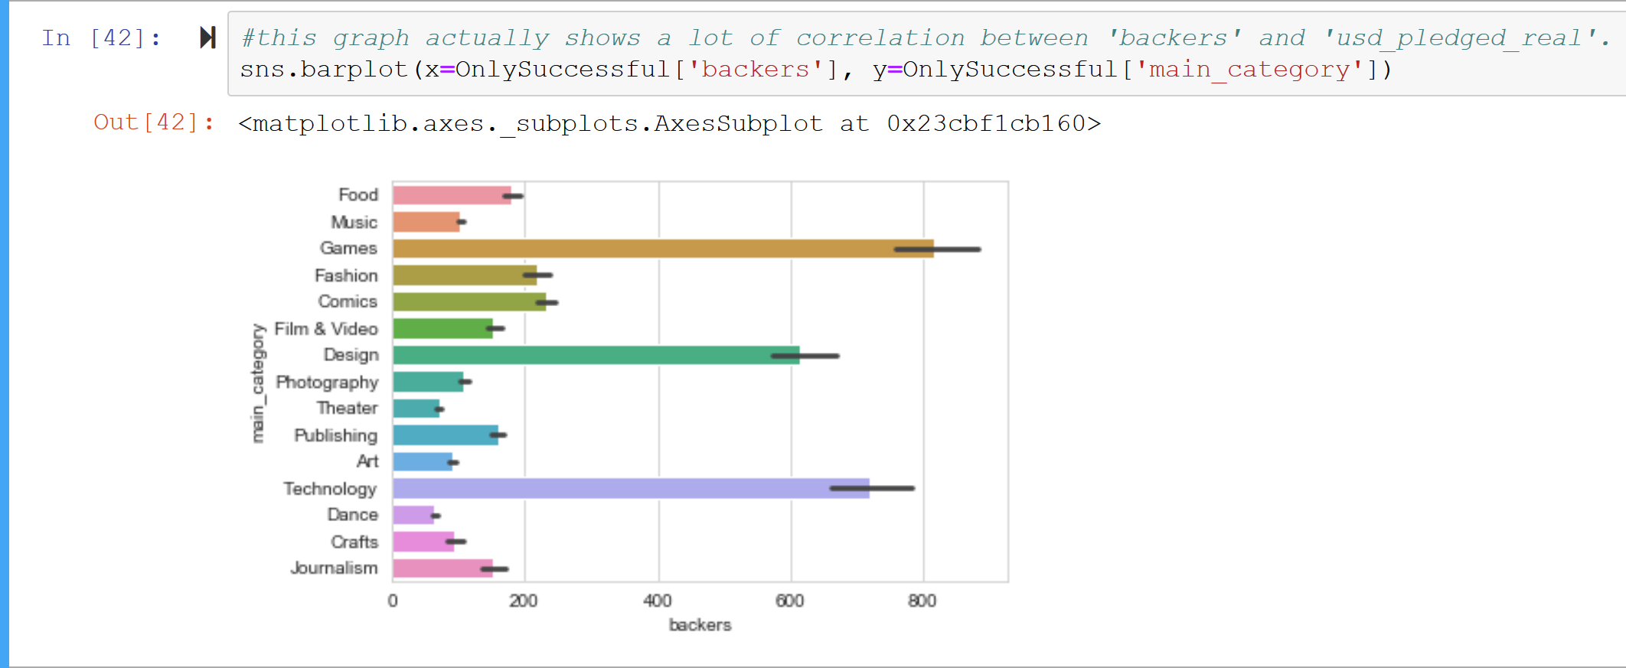
Number of backers/pledgers distributed between main categories. This shows how a strong correlation between quantity of backers and monies raised instead of a select few high value donations.w

Slide 14
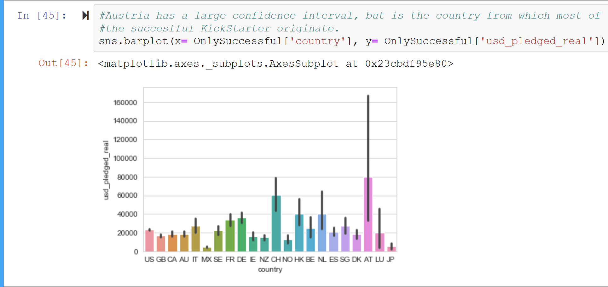
What countries do most of these successful campaigns originate? Austria and China

Slide 15
What does this all mean?
- We can predict the success of a campaign utilizing a linear regression model.
- The model can predict the funds that will be collected for a successful campaign.
​Utilizing a linear regression model:
85% accuracy

Slide 16
Thank you for time and have a good day.

